Slide 1
Ontario Prices & Income Trends
Lena Hammoud

Slide 2
Project Introduction
This project analyses the change in the housing prices over time in the Ontario region. Also analysed, is if there is any increase or decrease in the housing prices due to COVID-19.
Below are four questions which will be answered through the analysis:
How are housing prices changing over time?
What are the housing price trends across different regions in Ontario ( 2018 vs 2021)?
How has housing affordability changed over time?
How has housing prices been affected by COVID-19?

Slide 3
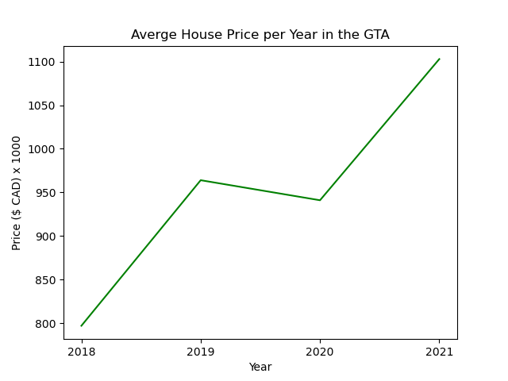
How are house prices changing over time?
Housing prices are increasing, with occasional fluctuations due policy and regulatory changes across all regions. This graph shows the average prices in Toronto, Durham, Halton, Peel & York from 2018 to 2021

Slide 4
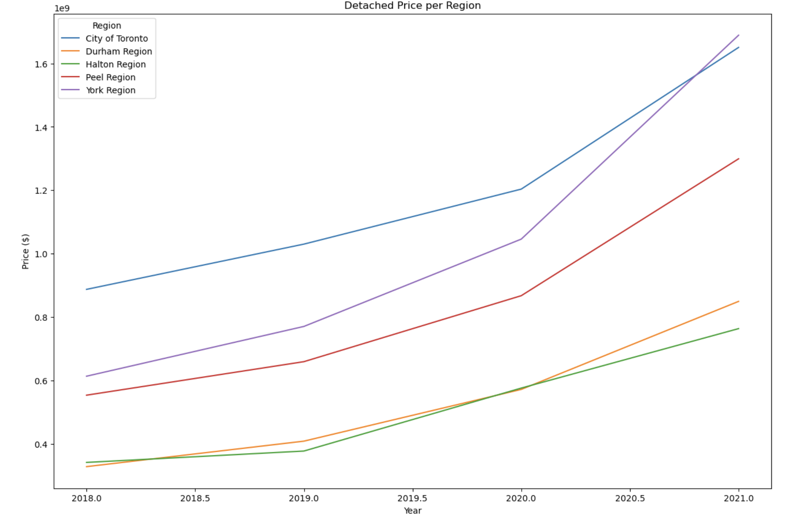
Housing Price Trends per Region ( Detached )

Slide 5
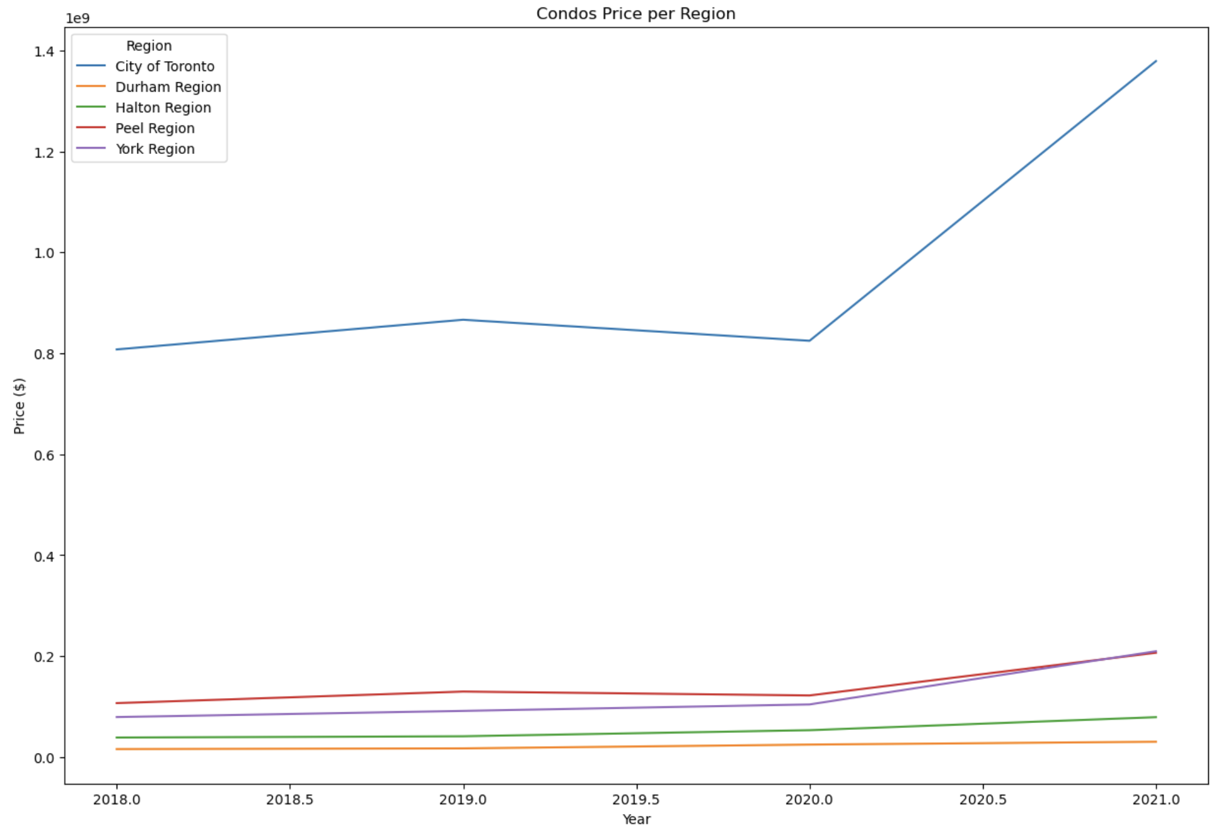
Housing Price Trends per Region ( Condos )

Slide 6
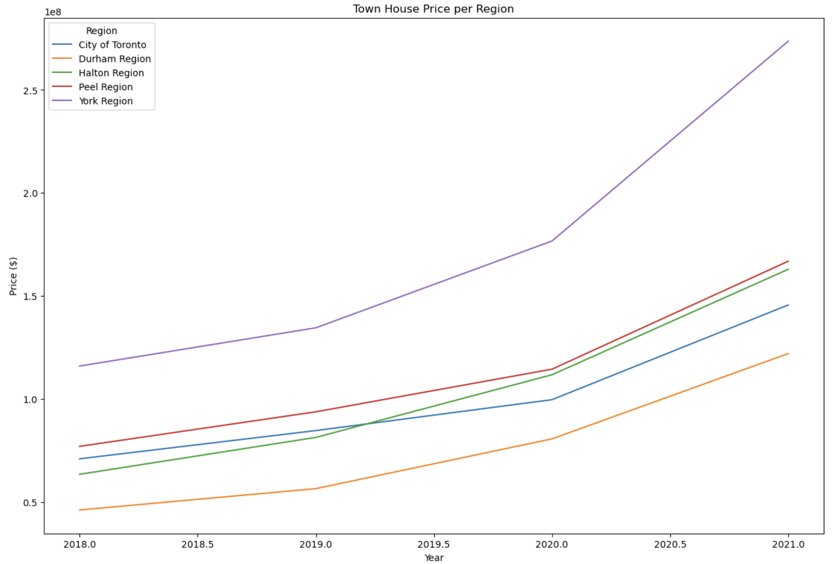
House Price Trends per Region ( Town House )

Slide 7
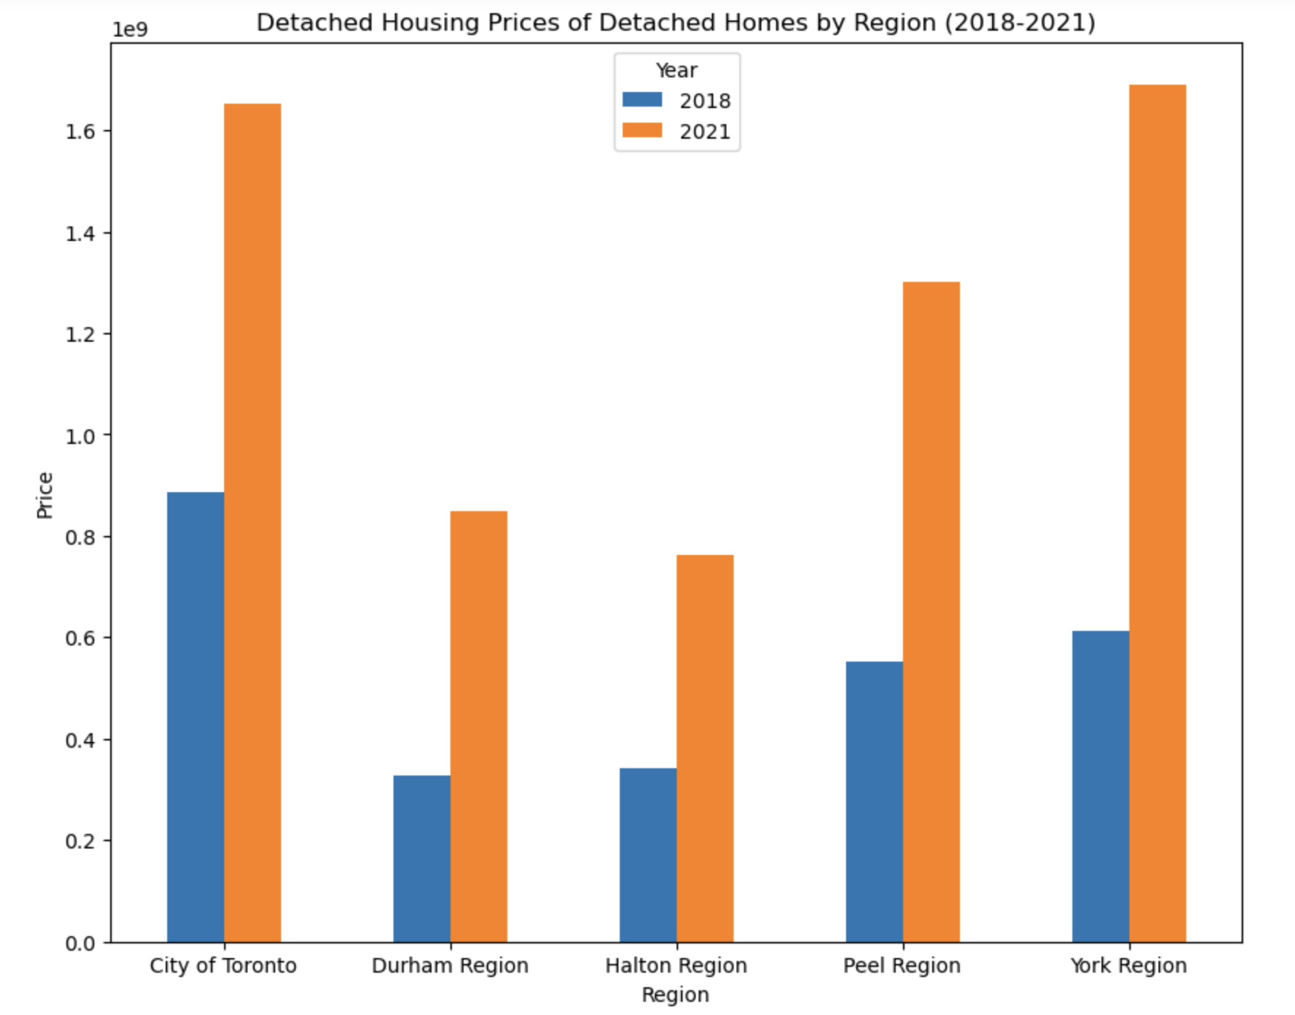
2018 - 2021 Comparison ( Covid-19 ) - Detached Homes
With the Bar Graph below you will see the increase of Detached homes that has occurred in 2021 after the pandemic.

Slide 8
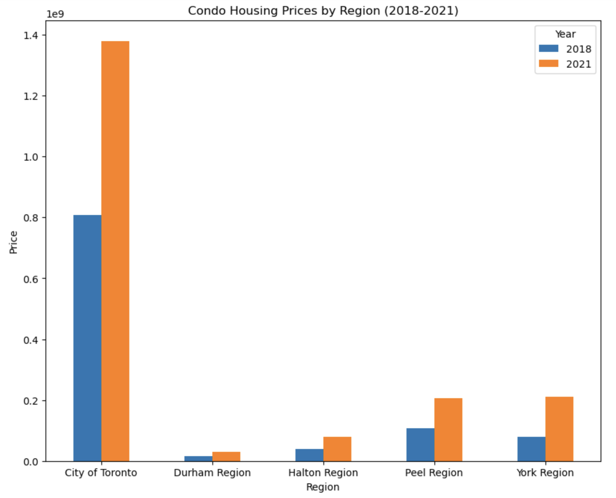
2018 - 2021 Comparison ( Covid-19 ) - Condo Homes

Slide 9
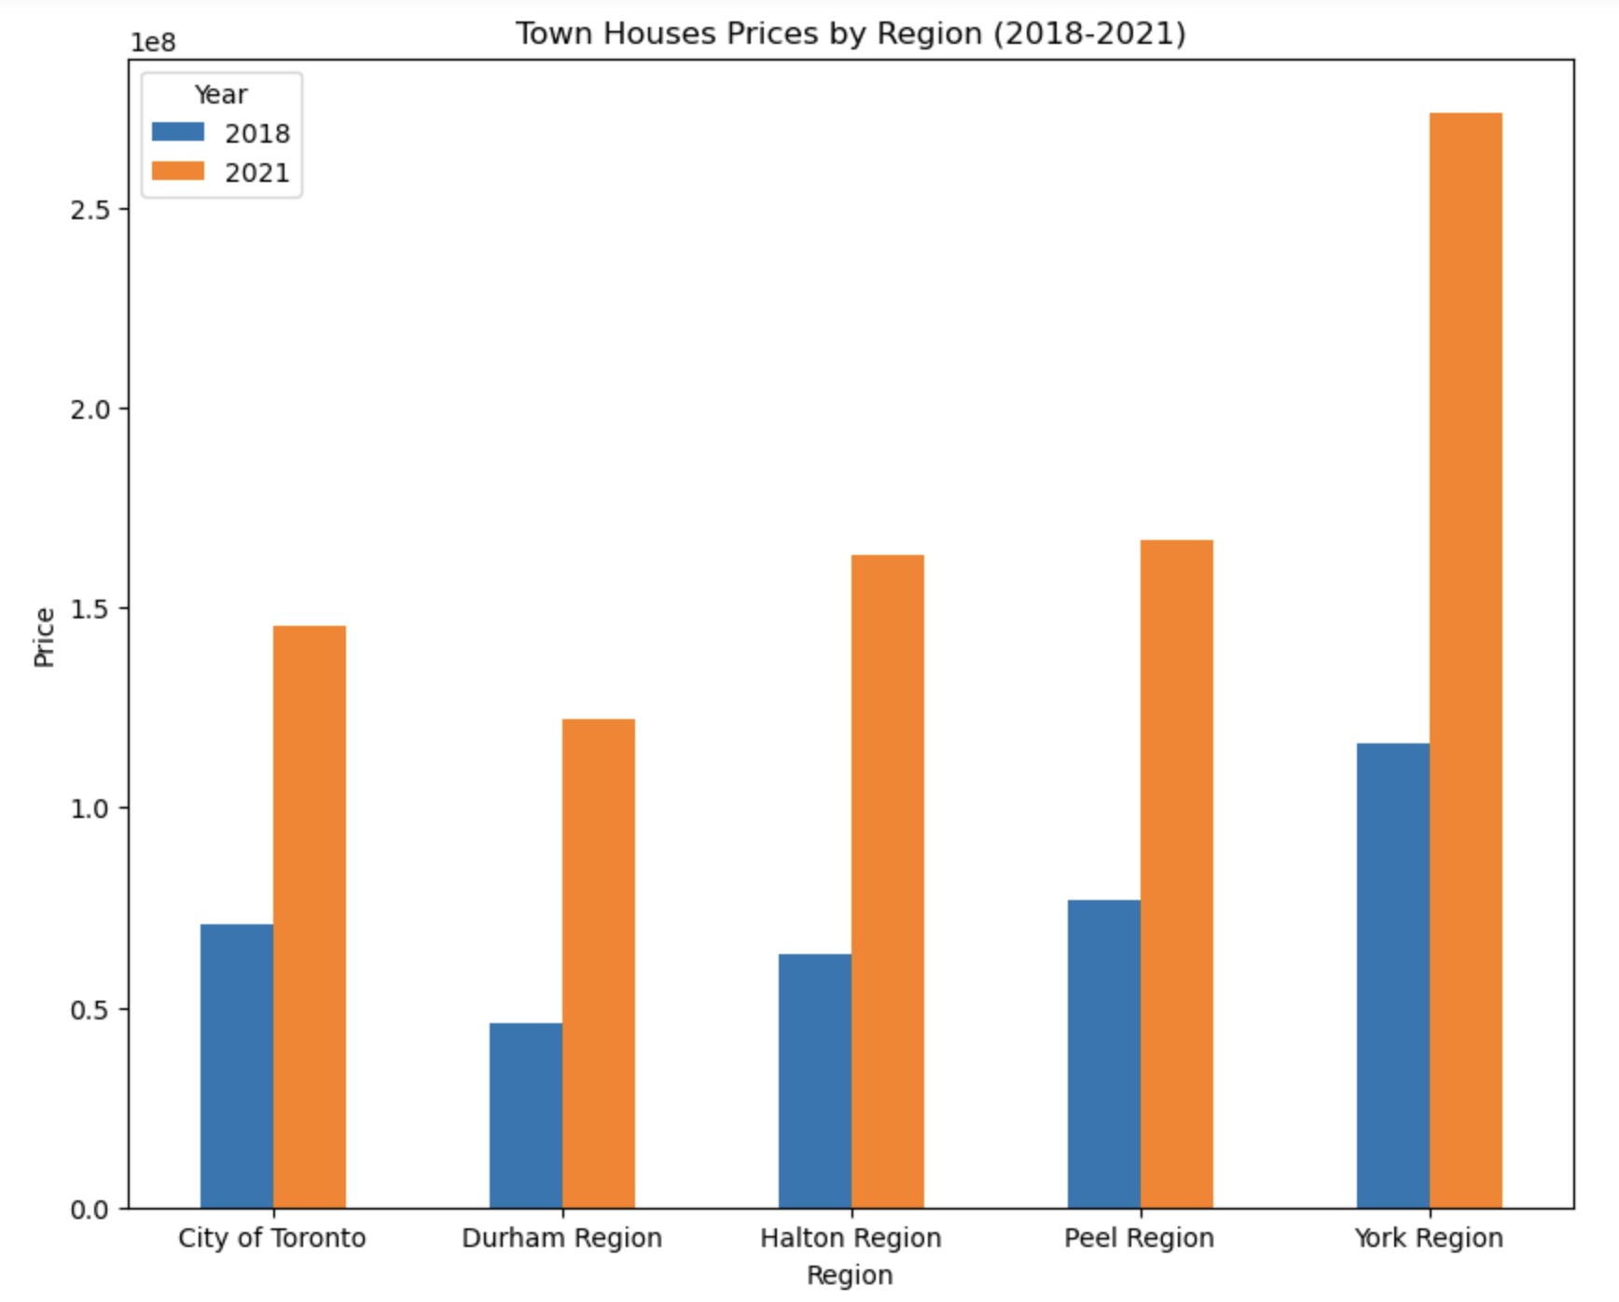
2018 - 2021 Comparison ( Covid-19 ) - Town Houses

Slide 10
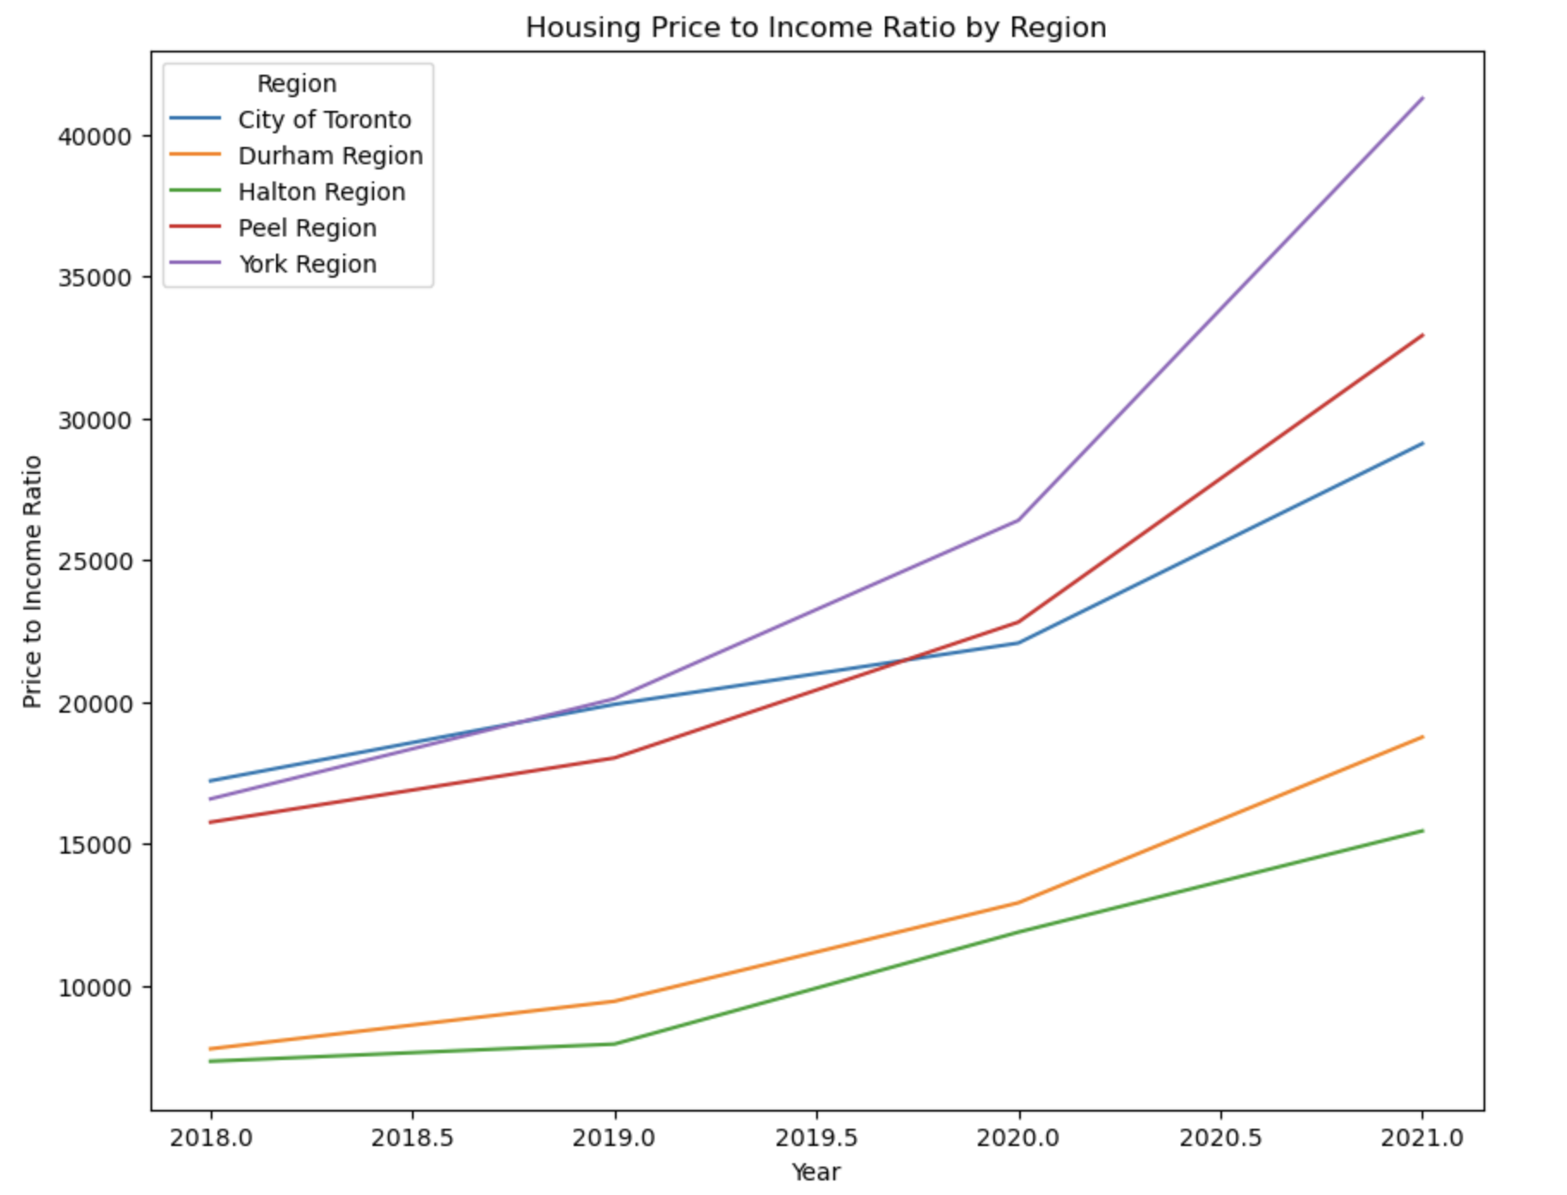
House Affordability
https://www.halton.ca/getmedia/0eb6baec-8dc3-4b27-bc68-7898c30a3f64/LPS-census-infographic-3-Income-families-households-marital-status.aspx
https://www.durham.ca/en/regional-government/resources/Documents/Council/CIP-Reports/CIP-Reports-2022/2022-INFO-79.pdf

Slide 11
How has housing prices been affected by COVID-19?
The COVID-19 pandemic had a significant impact on the real estate market. Here's how the surge in exuberance and the impact of COVID-19 on the housing market can be summarized based on the provided information:
1. Surge in Exuberance (2018-2019):
- Between 15-30% of houses and condos were selling for above the owner's asking price.
- This indicates a high level of demand and competition among buyers.
- Average prices were up 17% and 15% in February and March 2019, respectively.
- The market was characterized by strong seller's market conditions.
2. Impact of COVID-19 (2020):
- In February and March 2020, 50-60% of houses and condos were selling for more than the seller's asking price.
- Despite the onset of the pandemic, the housing market initially experienced increased activity and higher prices.
- However, it's important to note that these figures may vary depending on the specific region or housing market being considered.
It's worth mentioning that the real estate market can be influenced by various factors, and the impact of COVID-19 on housing markets can vary by location. Local economic conditions, government interventions, and other factors can also play a significant role in shaping the housing market dynamics during and after the pandemic.

Slide 12
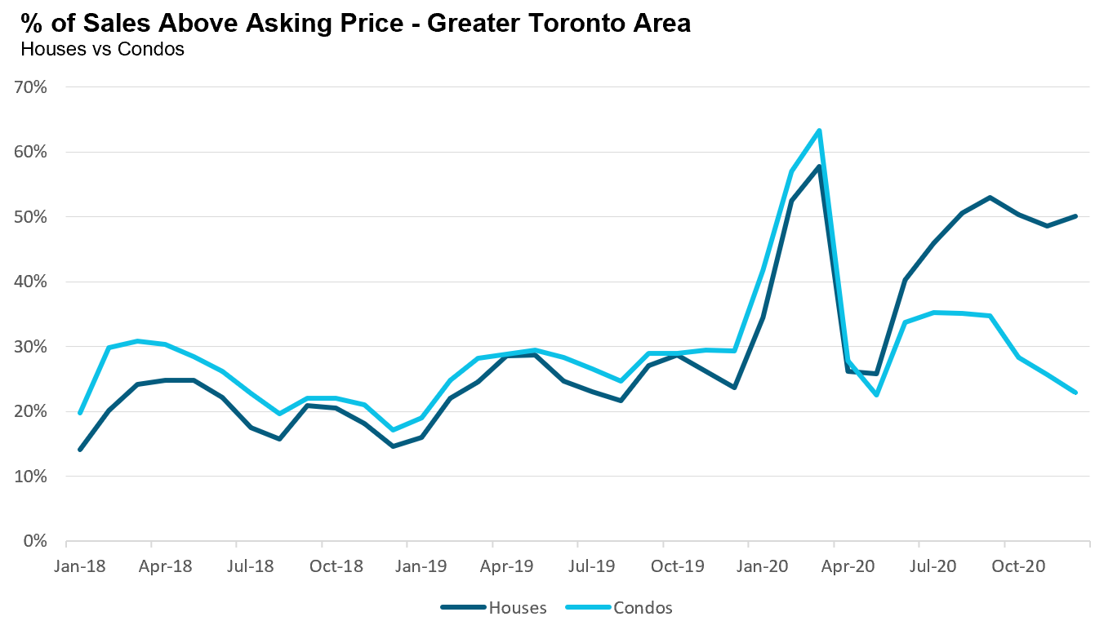
https://www.movesmartly.com/articles/2020-year-in-review-covid19-impacts-on-toronto-real-estate

